Slide 1
Programming pradgism - Functional programming -
Type & type class

Slide 2

1. Type
What is a type of function?
Take example: add x y = x + y.
In Z language:
add: $ℕ×ℕ→ℕ$
In Haskell:
add:: Int $→$ Int $→$ Int
Type signature

Slide 3
1. Type variable
ghci> :t head
head :: [a] -> a
What is the mean of [a] ?

Slide 4
2. Type class
ghci> :t (==)
(==) :: (Eq a) => a -> a -> Bool
What is the mean of == ?

Slide 5
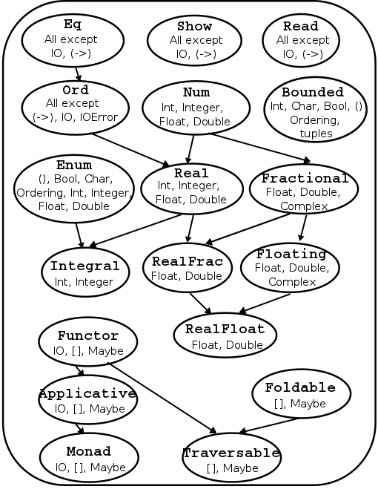
3. Basic type class

Slide 6
3. Basic type class
Eq
Ord
Read
Bounded

